Slide 1

How to predict reaction time?
Defensive
Muthu Jeyanthi, Bence Fogel, Yufang Wang, Sri Bhatta, Adrianna Nozownik

Slide 2
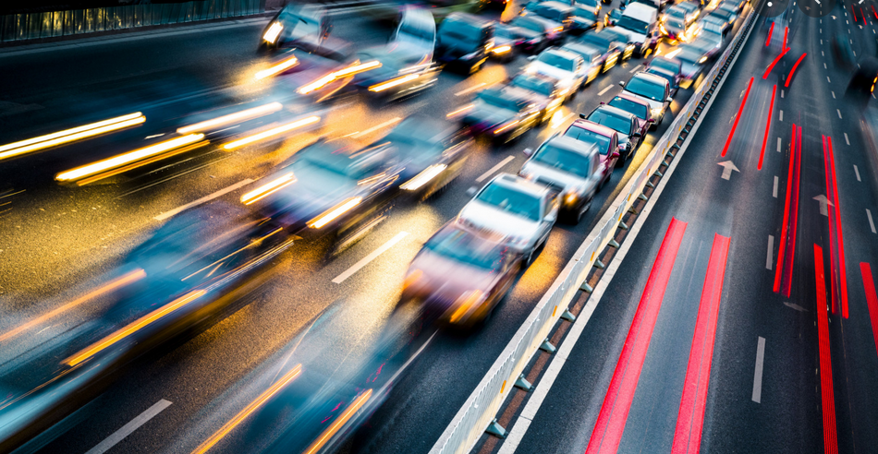
Why does the world need our model?
Reaction time prediction could save lives!

Slide 3
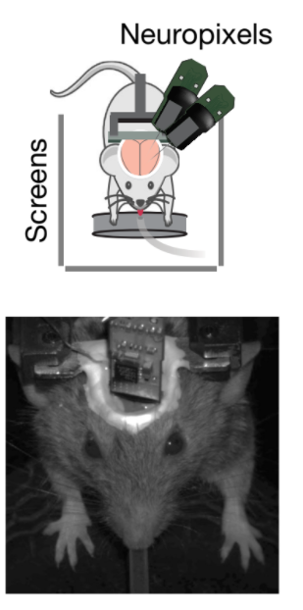
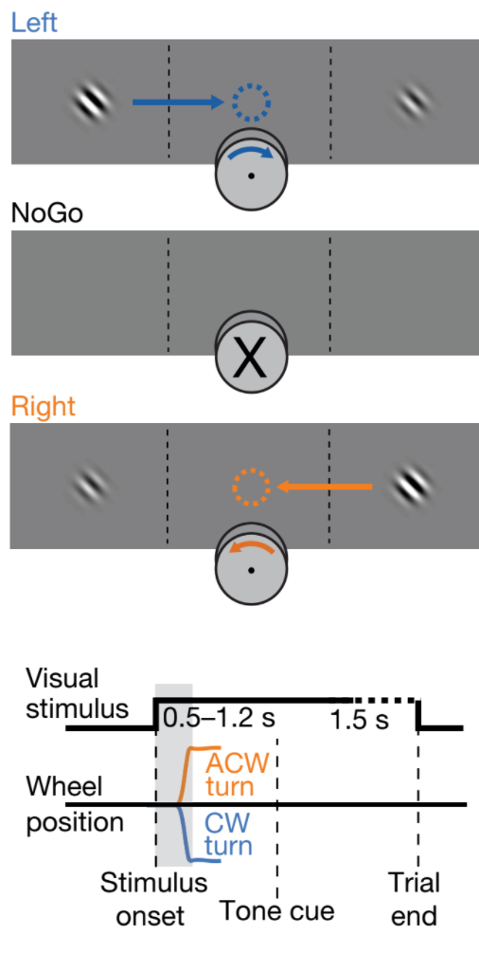
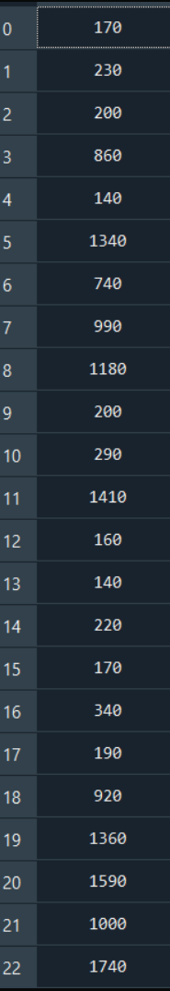

What is our model based on?
Go Cue → Reaction time
Data extraction:
Use neuronal activity to predict reaction time

Slide 4
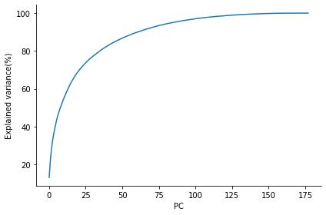
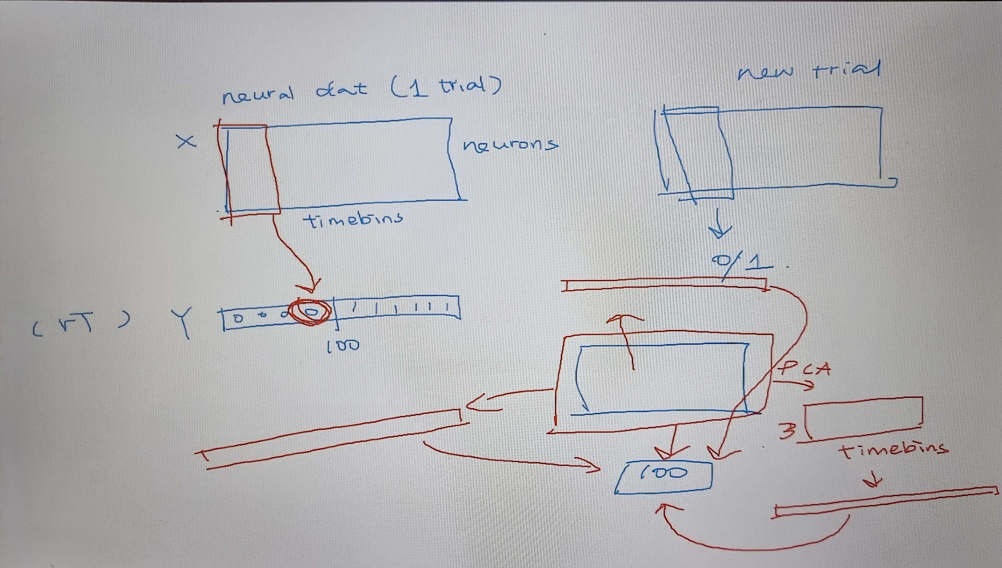
Correlation of reaction time variable and vis ctx activity
PCA struggles
Notes:
Hard time to figure out which time of pca matrix
Figured it out –
Chaotic sometimes – matrix shapes hard to imagine – we were proud in th eend

Slide 5
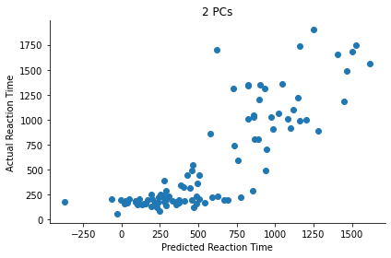
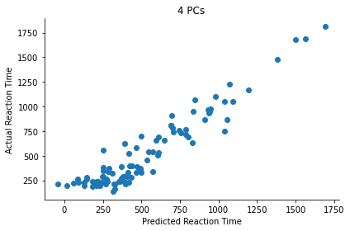
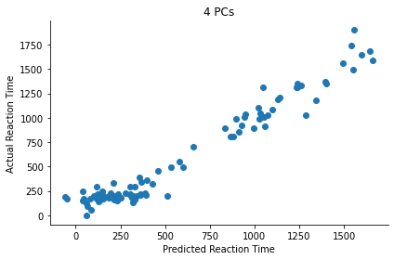
Differences in decoding performances based on PC number and brain area
Prim. Visual Cortex
Olfactory bulb
Notes:
Different number of PCs result in different decoding performances
Using other brain areas activity data, we got different decoding performances

Slide 6
Conclusions
Using only few PCs, we had good decoding performance
Reaction time is encoded by many brain areas
Best decoding performance in VISp
Future of the idea:
Explore brain regions responsible for reaction time
expand model with other brain regions to decode more precisely

